Slide 1
Advanced Sprint –Part 2 Loading Data in the Data Warehouse

Slide 2
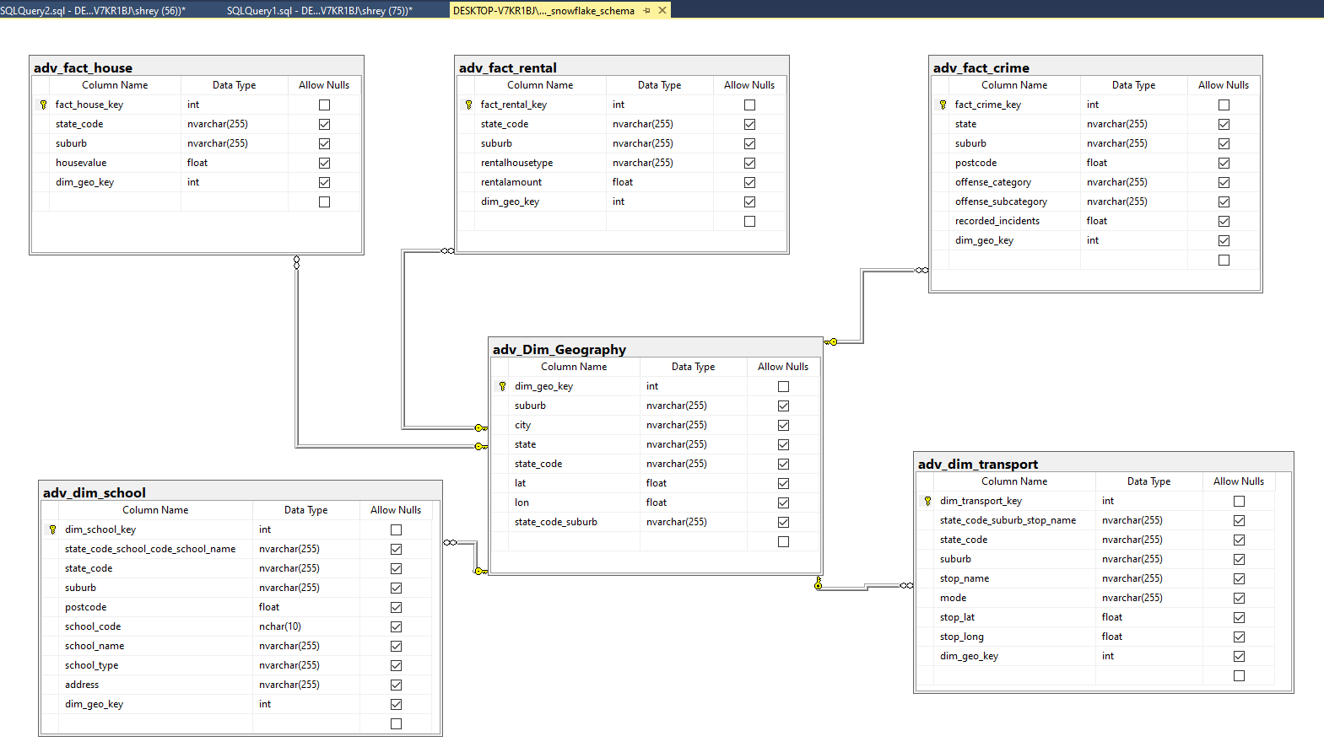
SNOWFLAKE MODEL

Slide 3
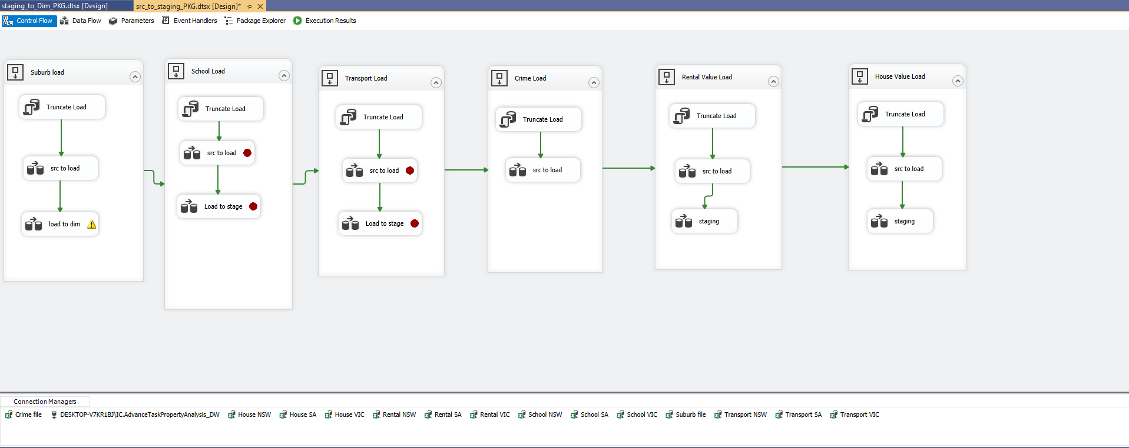
SSIS Package Loading data from Source to staging tables

Slide 4
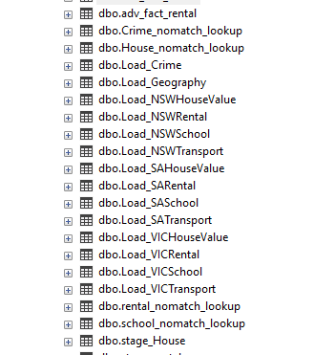
Load Tables Generated in the Data Warehouse

Slide 5
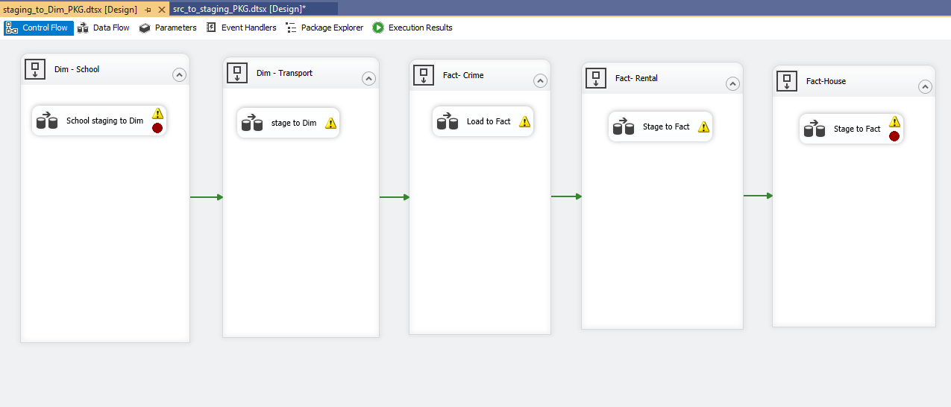
SSIS Package Deriving Data from Staging tables to Dim and Facts tables in the Data Warehose

Slide 6
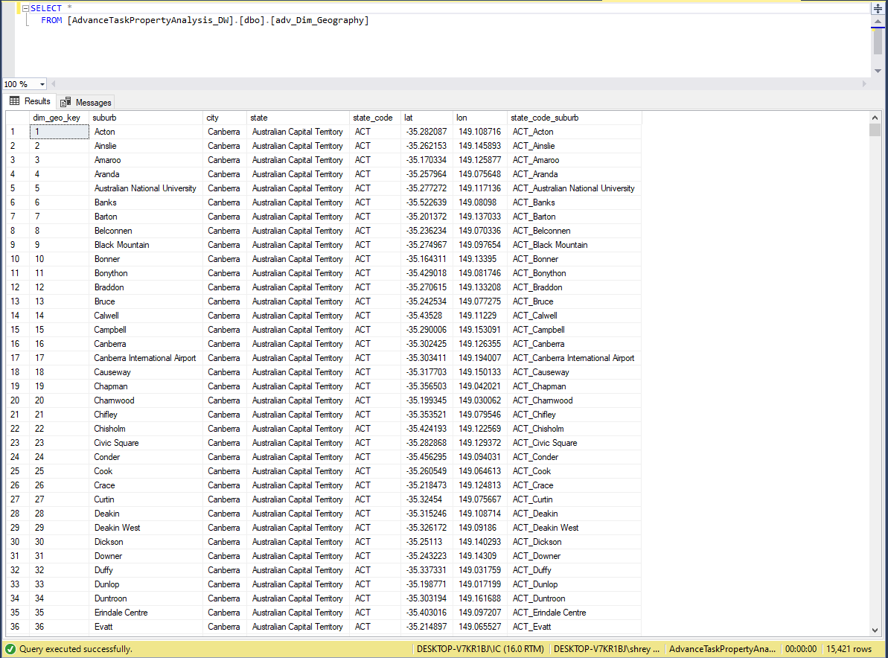
Dim_Geography Table

Slide 7
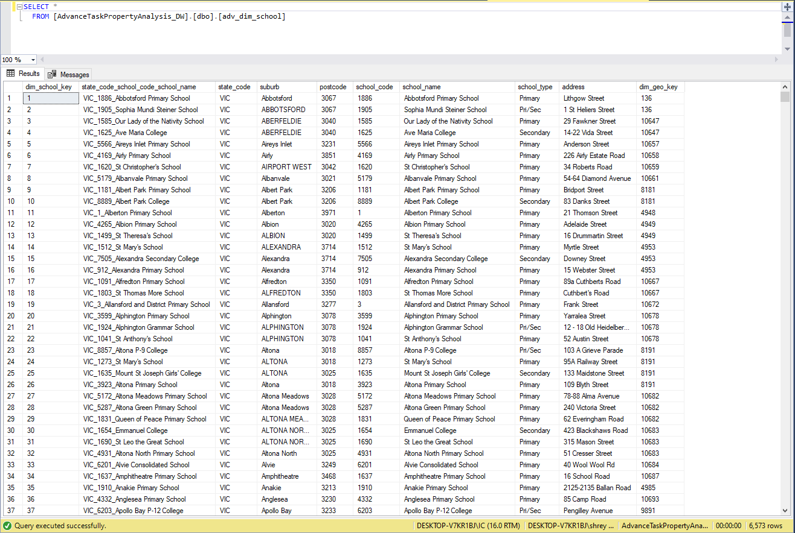
Dim_School Table

Slide 8
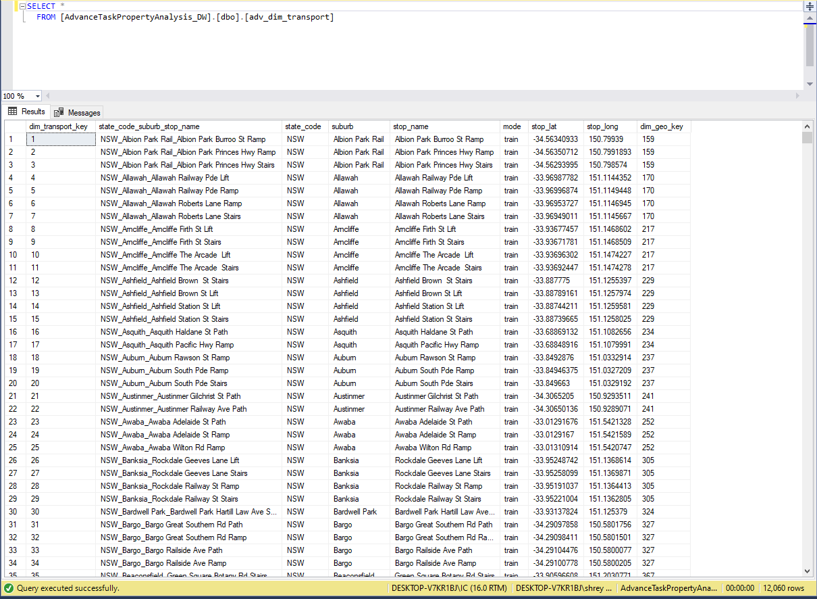
Dim_Transport Table

Slide 9
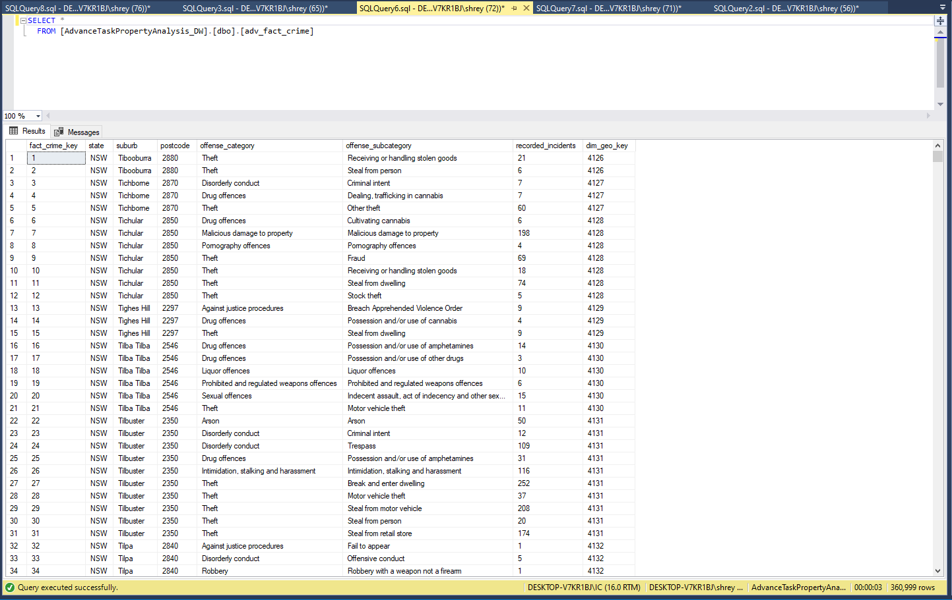
Fact_Crime Table

Slide 10
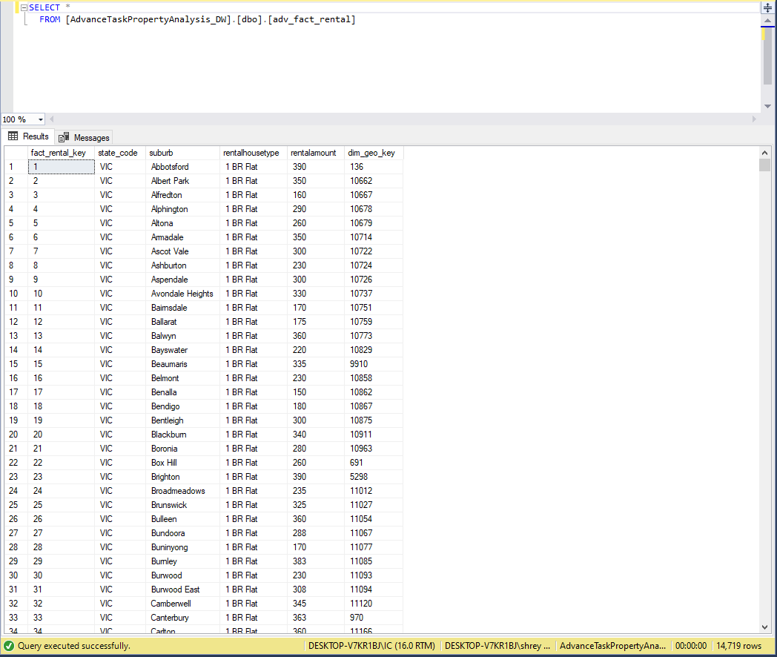
Fact_Rental Table

Slide 11
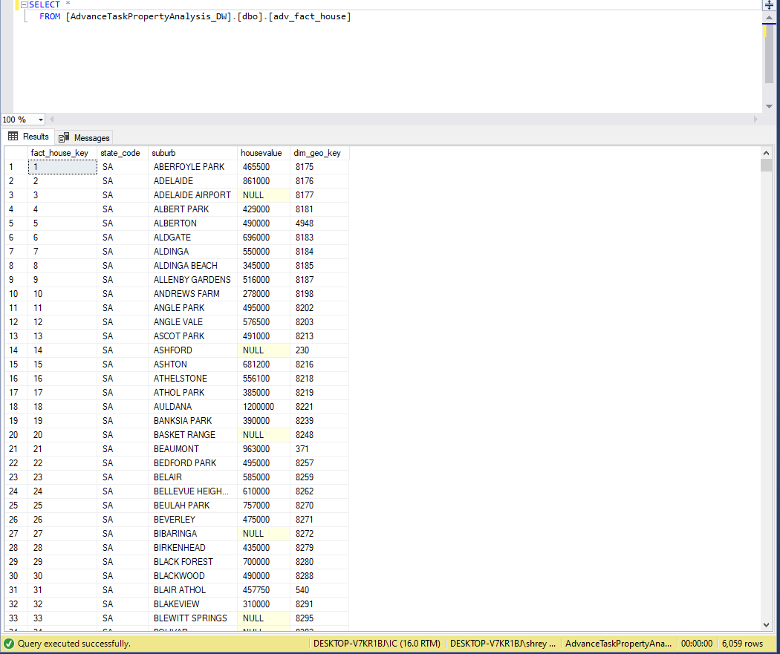
Fact_House Table

